Slide 1


Data Carpentry Genomics
Introduction
Experimental data
Workshop overview

Slide 2
Data Carpentry Genomics
Introduction
Experimental data
Workshop overview

Slide 3
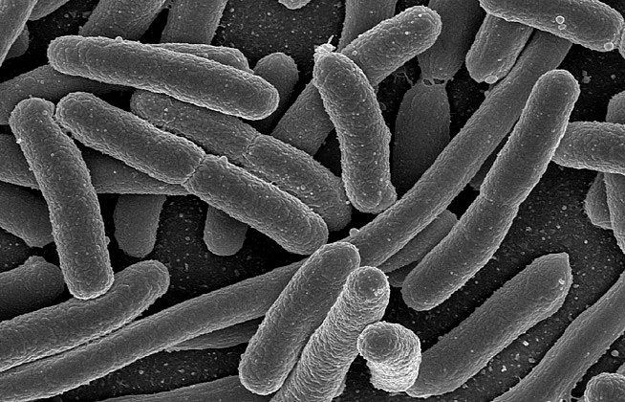
E. coli Under the Microscope (Scanning Electron Micrograph)

Slide 4
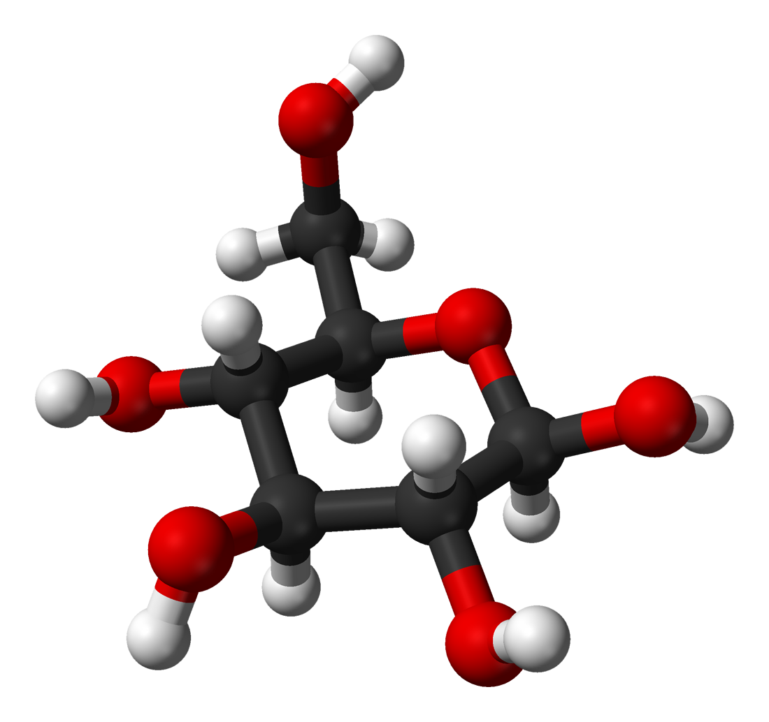
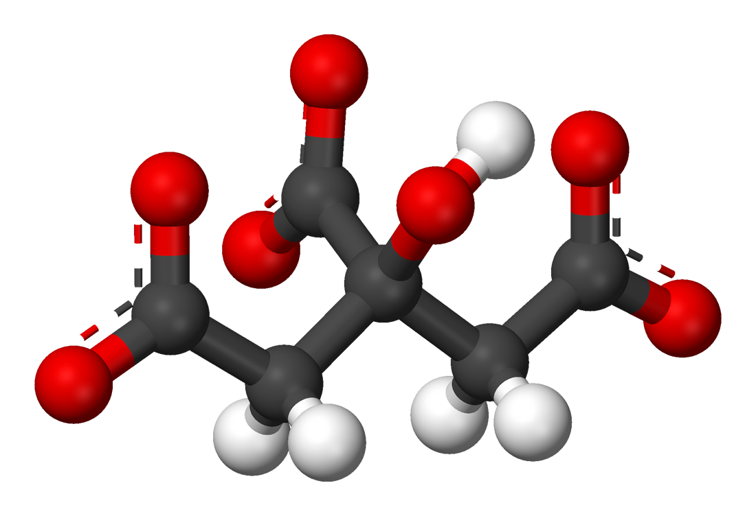
E. coli (Escherichia coli)
Prokaryotes: single copy of their circular chromosome per cell
Aerobic AND Anaerobic metabolism:
Uses oxygen when available, using the same glycolysis and the citric acid cycle pathways found in eukaryotes to generate energy from carbon-containing molecules like glucose.
Citrate can only be metabolized by E. coli in the absence of oxygen.
Easy to grow and maintain
Short reproduction time ≈20 min
Glucose
Citrate

Slide 5
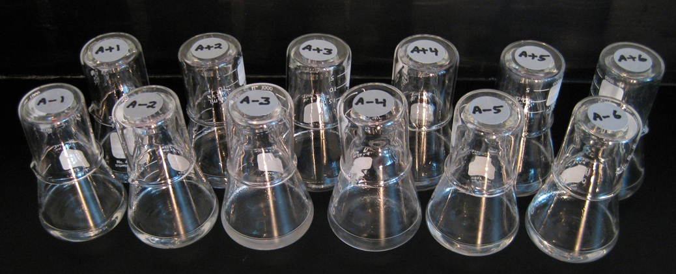
E. coli long-term evolution experiment (LTEE)

Slide 6
E. coli long-term evolution experiment (LTEE)

Slide 7
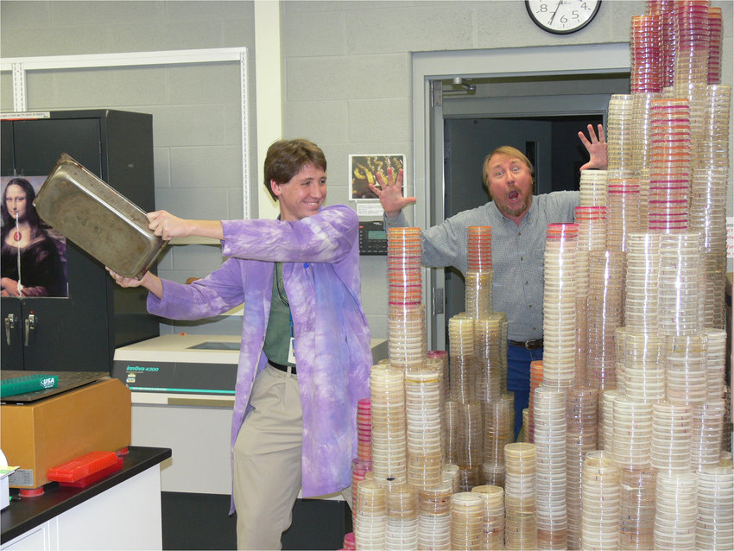
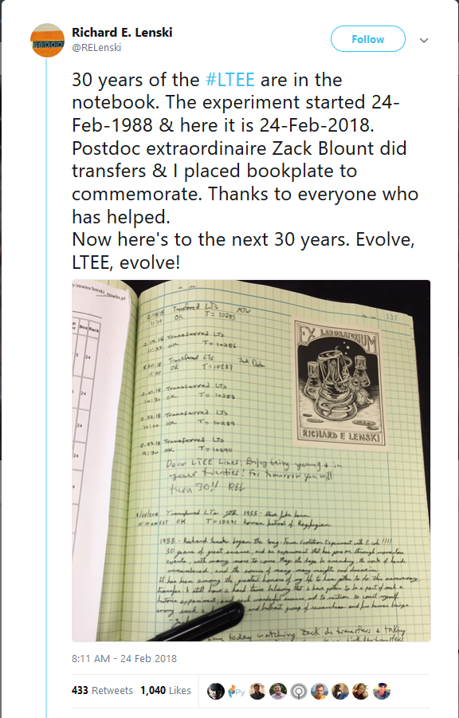
The data in Blount et al. 2012 is restricted to populations from one of those initial populations.

Slide 8

E. coli long-term evolution experiment (LTEE)

Slide 9
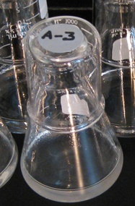
Data Carpentry Genomics data set
Growth medium contains small amount of glucose (food source) and citrate (helps E. coli obtain iron from medium)
Around 33,000 generations (≈15 years into the experiment!), E.coli population could grow aerobically on citrate (Cit⁺)
Remarkable: inability to grow aerobically on citrate (Cit⁻) is characteristic of E. coli as a species

Slide 10
“Back in 2008, this was really frustrating for those of us who wanted to know the molecular details. I'm sure this was frustrating for Blount and Lenski and their colleagues as well. We had no idea how difficult it would be to sort out the mutations. Now we know, and the photo of Zachary Blount with all his Petri dishes drives home the point.”
Laurence A. Moran (Professor Emeritus in the Department of Biochemistry at the University of Toronto)

Slide 11
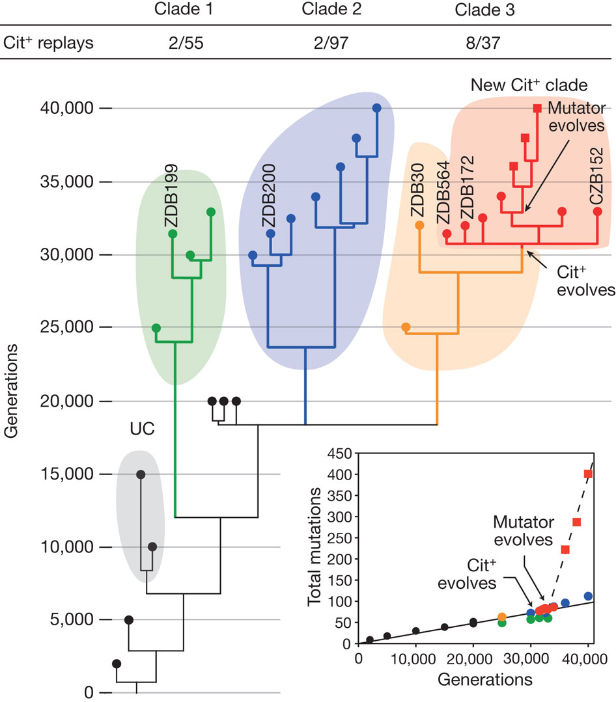
ZD Blount et al. Nature 489, 513–518 (2012)

Slide 12
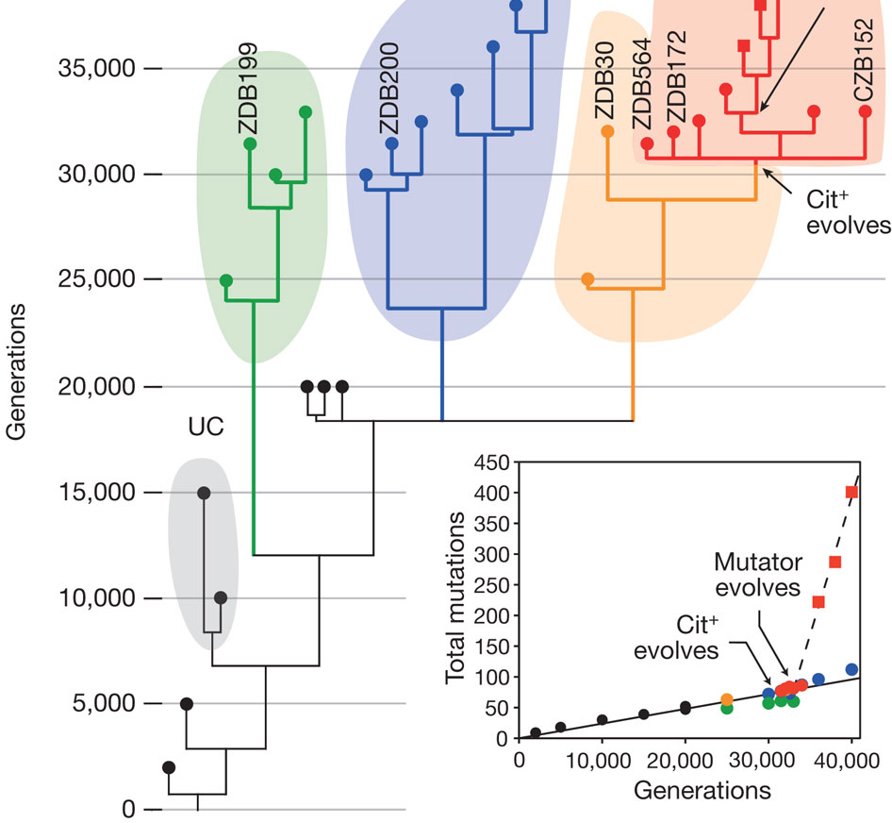
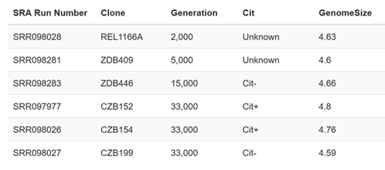
DC Genomics data set
For the purposes of this workshop we’re going to be working with 6 of the sequence reads from this experiment. We also made up genome sizes for each of the strains, to look at the relationship between Cit status and genome size. The genome sizes are not real data!!

Slide 13
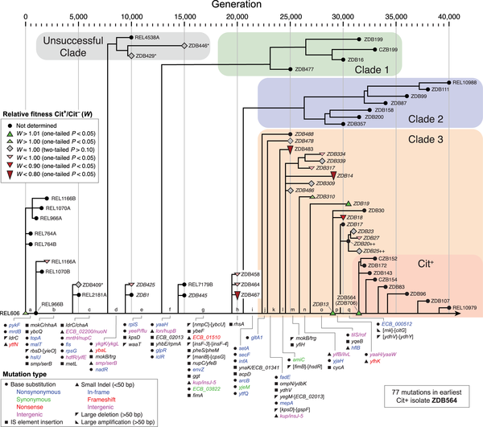
D. Leon et al. PLOS Gen. (2018)

Slide 14
Data Carpentry Genomics
Introduction
Experimental data
Workshop overview

Slide 15

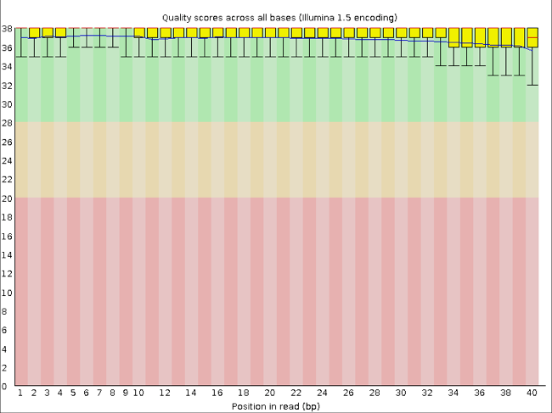
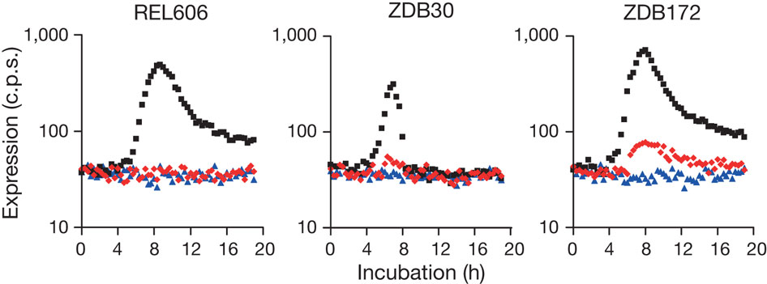
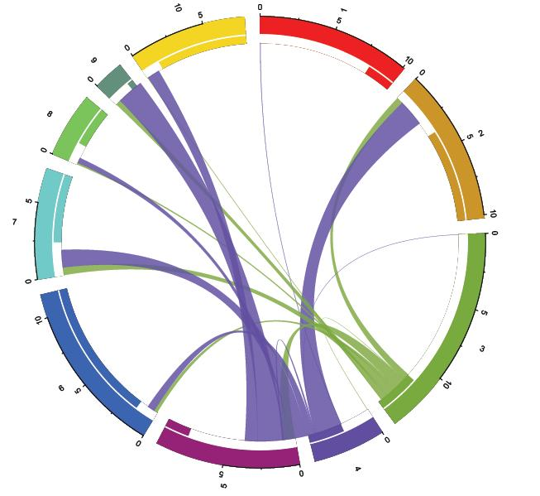
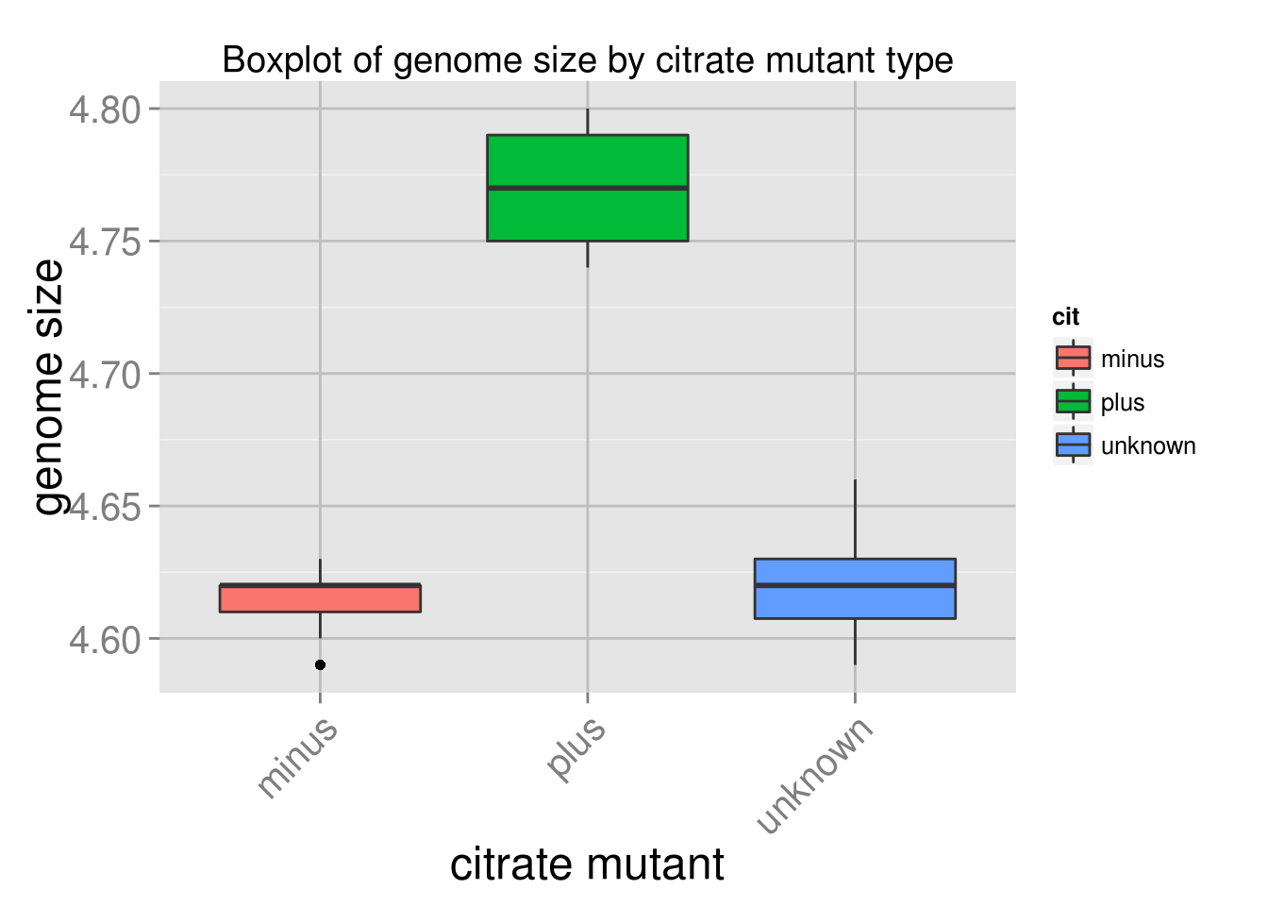
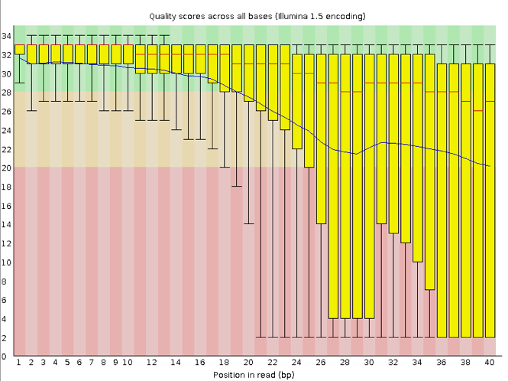
Set up project Process data Analyze & visualize

Slide 16
Set up project Process data Analyze & visualize
① Tuesday morning:
Project organization
Metadata files
Open data

Slide 17
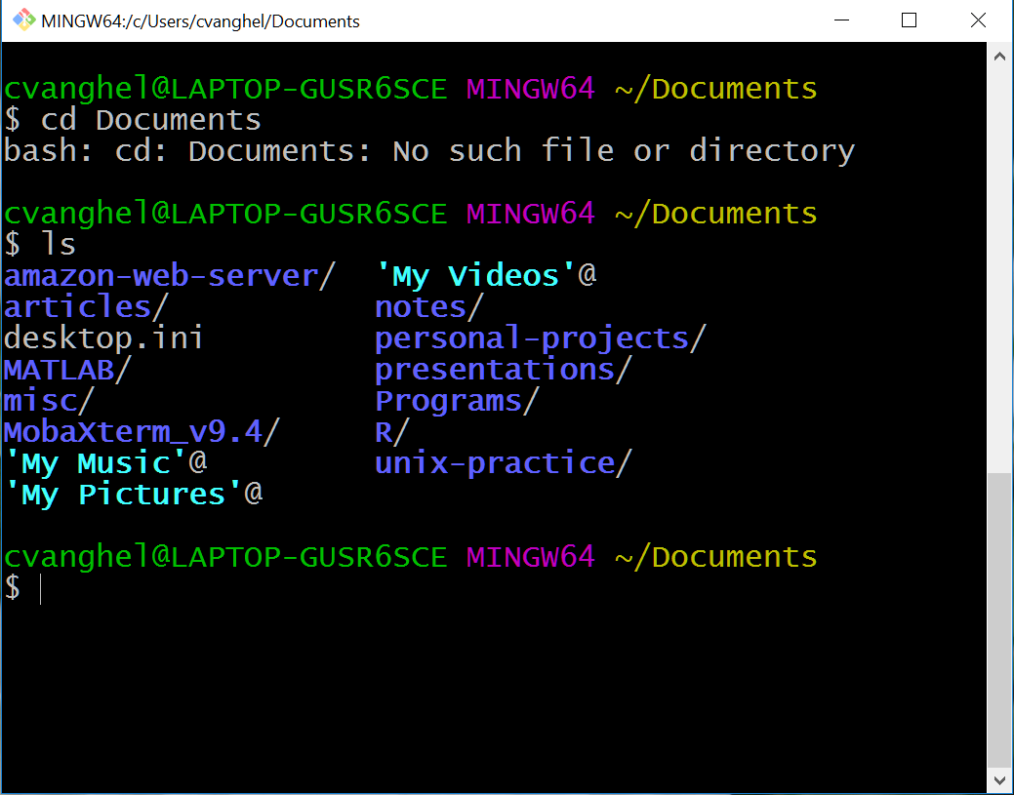
Set up project Process data Analyze & visualize
② Tuesday afternoon:
Unix command line
Fast,
Repeatable &
Reproducible data processing

Slide 18
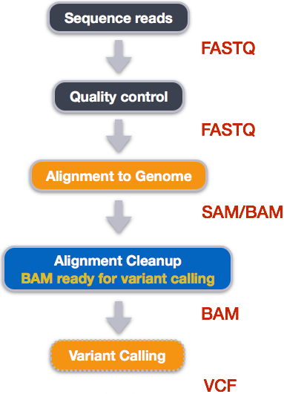
Set up project Process data Analyze & visualize
③ Wednesday morning & afternoon: Sequencing pipeline
Quality control of read data
Alignment to genome
Variant calling

Slide 19
Set up project Process data Analyze & visualize
④ Wednesday afternoon:
Data analysis with R
Manipulate data tables
ddpyr
Make plots

Slide 20

References
Asd
https://commons.wikimedia.org/wiki/File:EscherichiaColi_NIAID.jpg
https://en.wikipedia.org/wiki/E._coli_long-term_evolution_experiment#/media/File:Lenski%27s_12_long-term_lines_of_E._coli_on_25_June_2008.jpg
Richard E. Lenski Twitter feed: https://twitter.com/RELenski/status/967431687260065792
https://www.researchgate.net/figure/Petri-plates-aplenty-Former-student-now-postdoc-Zachary-Blount-and-Richard-Lenski_fig2_279308783
Laurence A. Moran blog: https://sandwalk.blogspot.ca/2013/12/lenskis-long-term-evolution-experiment.html
ZD Blount et al. Nature 489, 513–518 (2012)
D. Leon et al. PLOS Genetics (2018)
http://www.molecularecologist.com/2014/12/migration-routes-as-circos-plots-in-r/
http://www.evo-ed.com

